Slide 1

PES WEB GAMES
PES WEB Gaming
-PRATHAM R SHETTY
PES2UG21CS392
-R RANJEEVE
PES2UG21CS406
-R GAGANA REDDY
PES2UG21CS421

Slide 2
Our project is aimed at developing a website for online gaming. “PES WEB GAMES” provides an easy interface that would let the users to the pool of gaming.
It provides the users more pleasure and gladdening THEIR mind by playing these traditional games such as TIC-TAC-TOE, ROCK-PAPER-SCISSORS and GUESS THE NUMBER.
ABSTRACT

Slide 3

We’ve used basic concepts of our course WEB TECHNOLOGIES such as HTML ,JS and CSS .
On extension to that we also used
MongoDB-document database
Express(.js)-Node.js web framework
React(.js)-a client-side Javascript framework
Node(.js)-the premier Javascript web Server
CONCEPTS UTILIZED

Slide 4
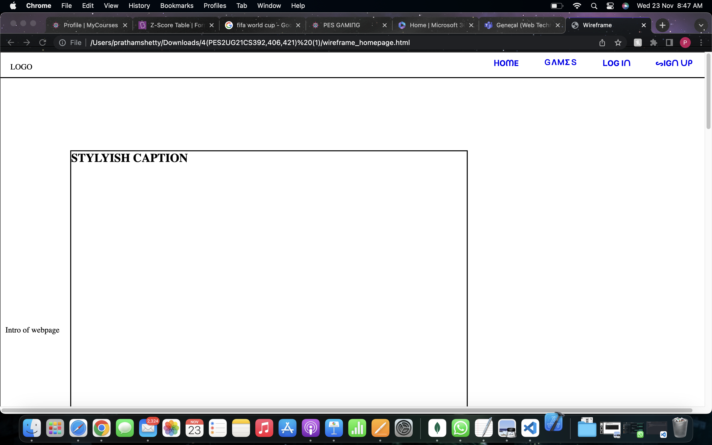
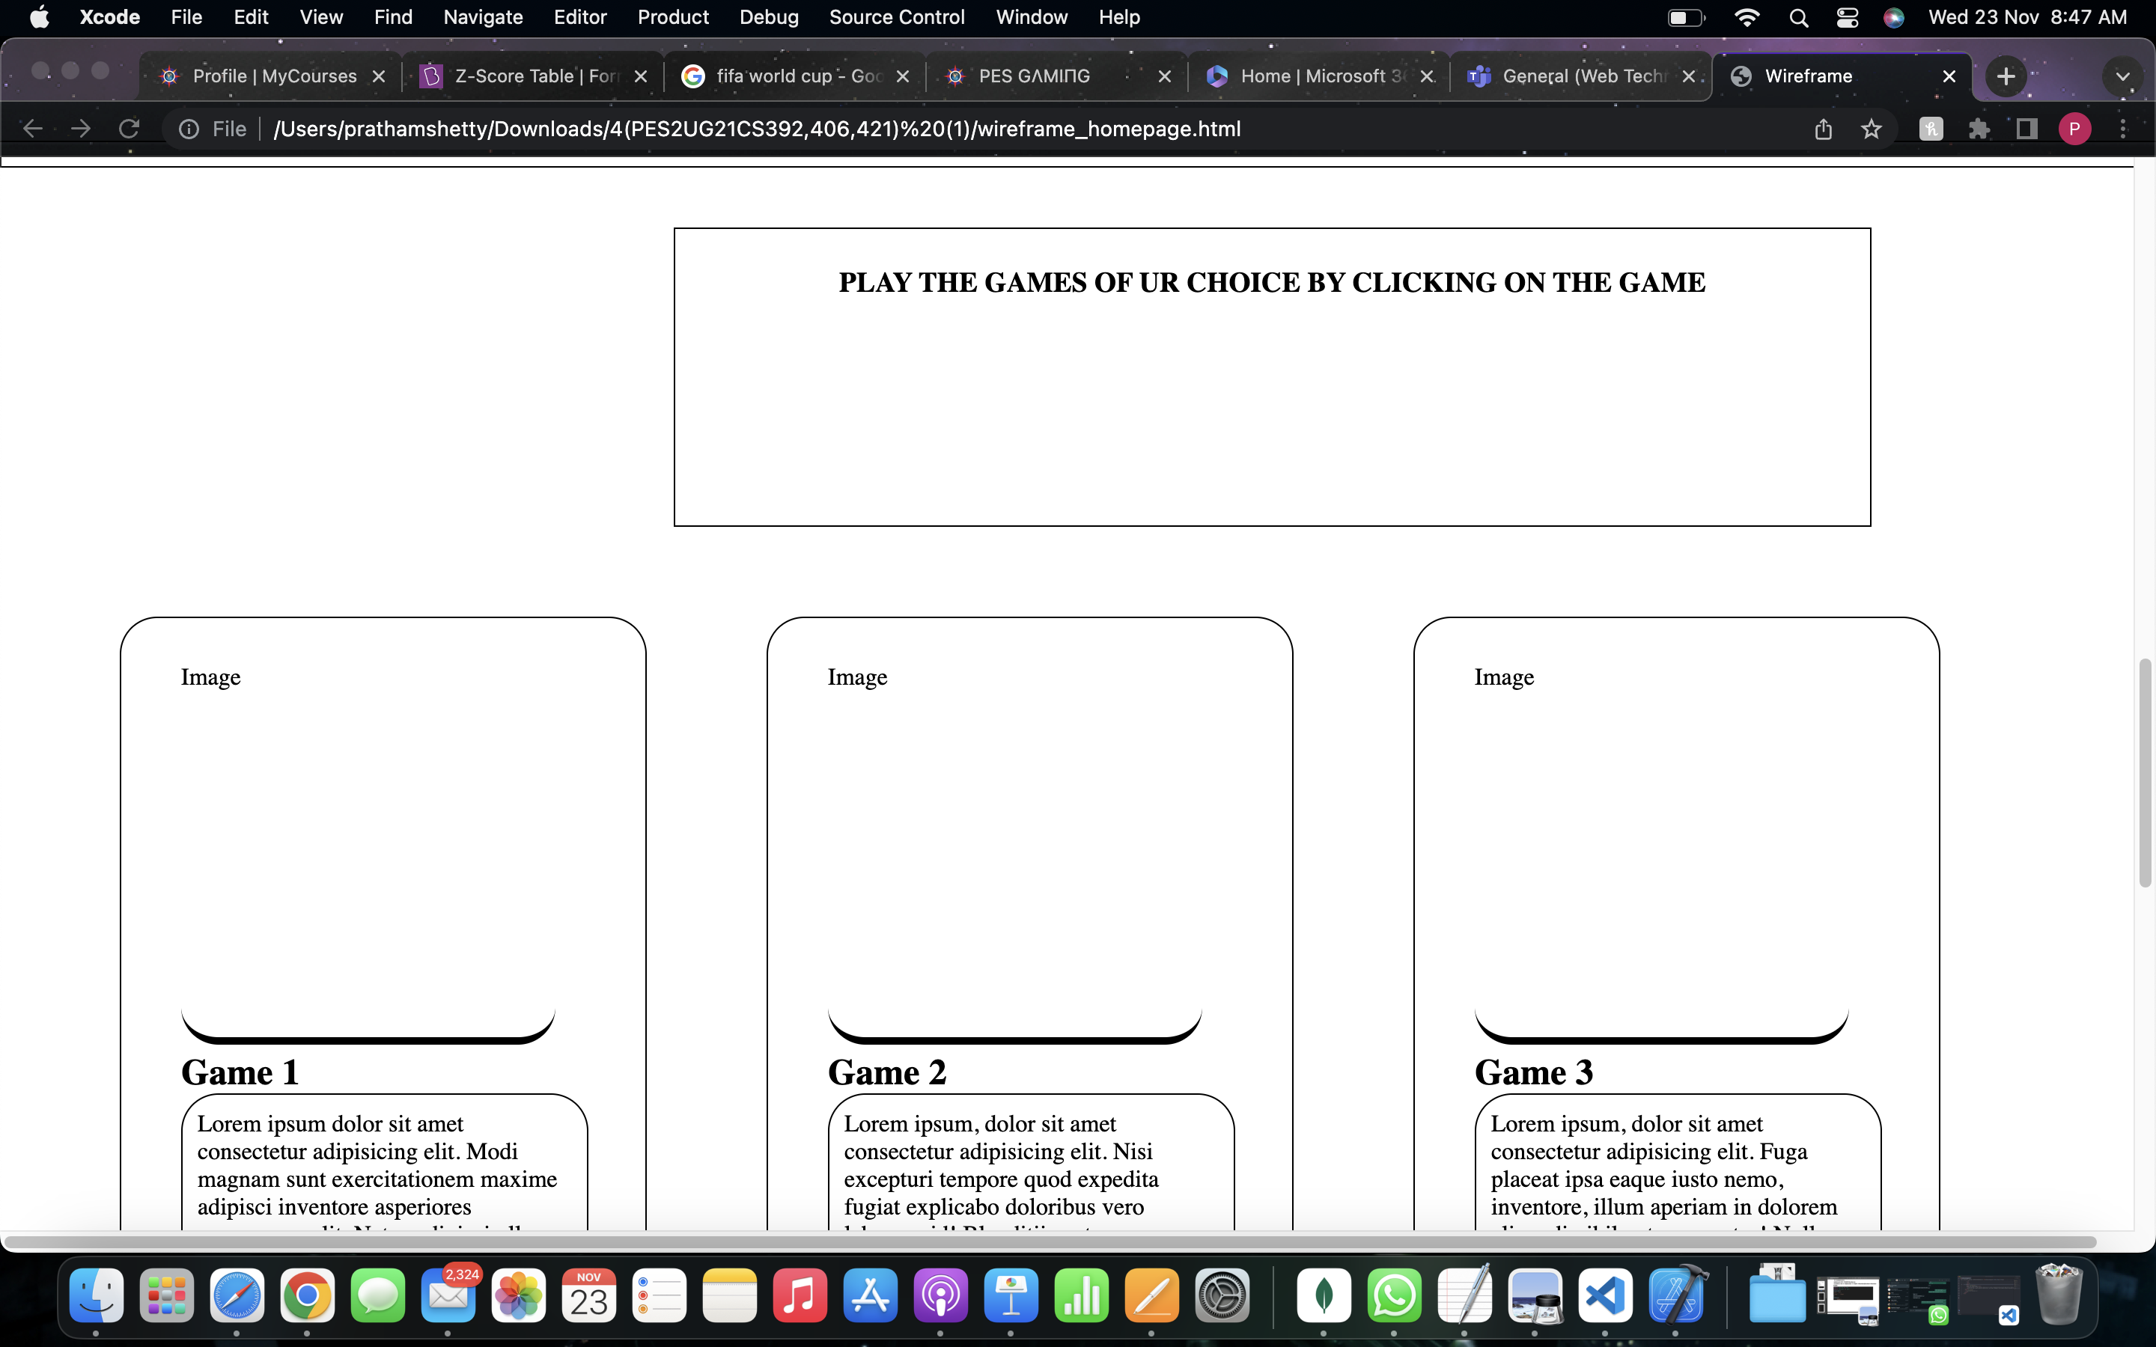
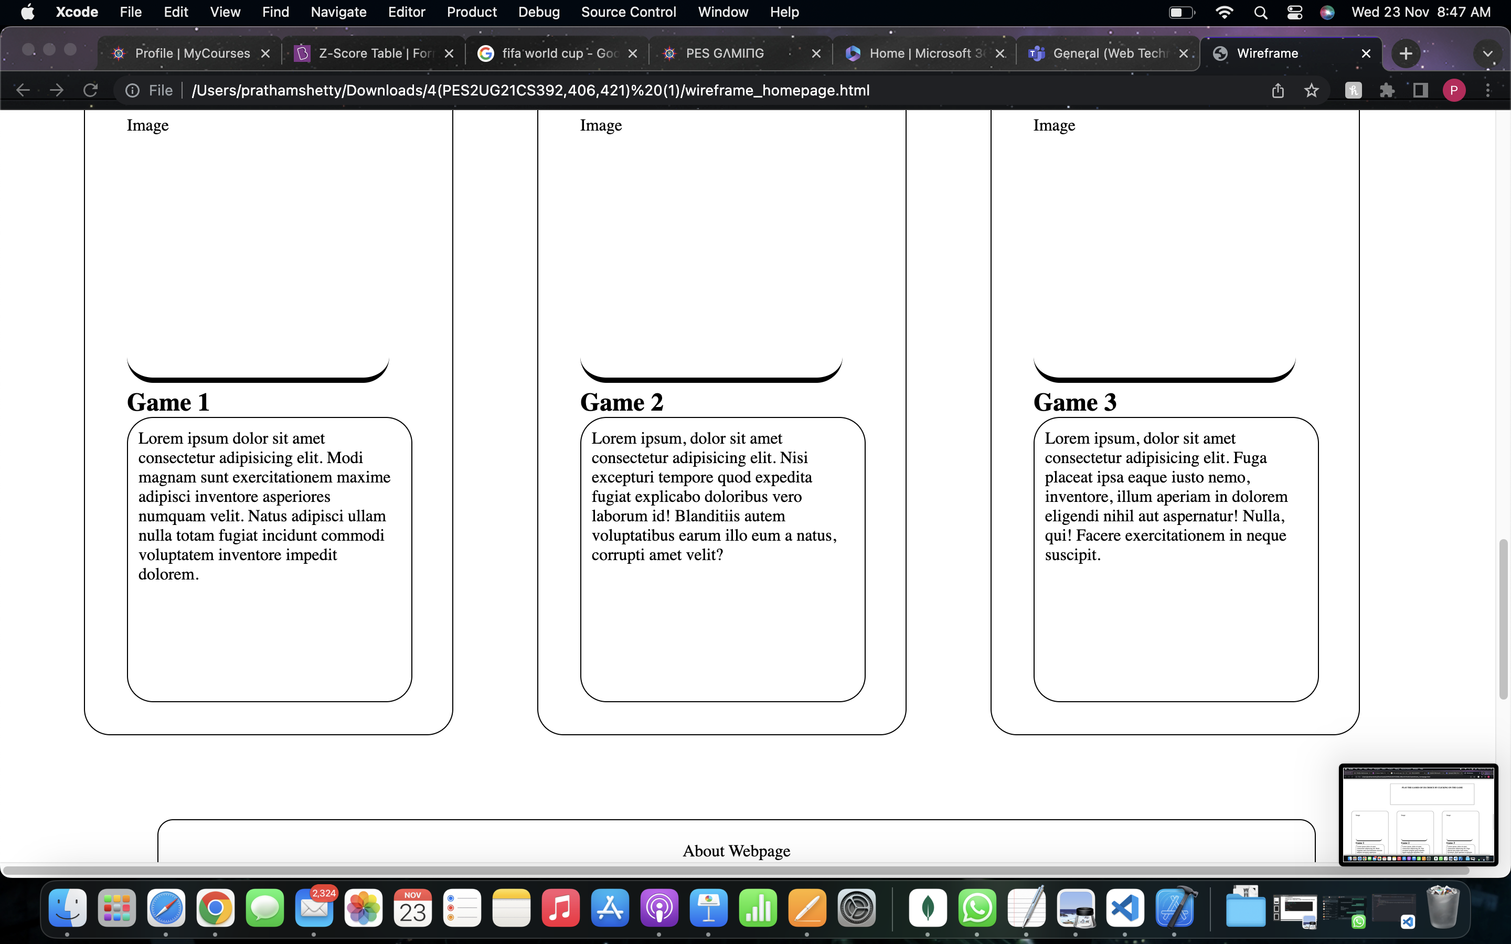
WIRE-FRAME

Slide 5
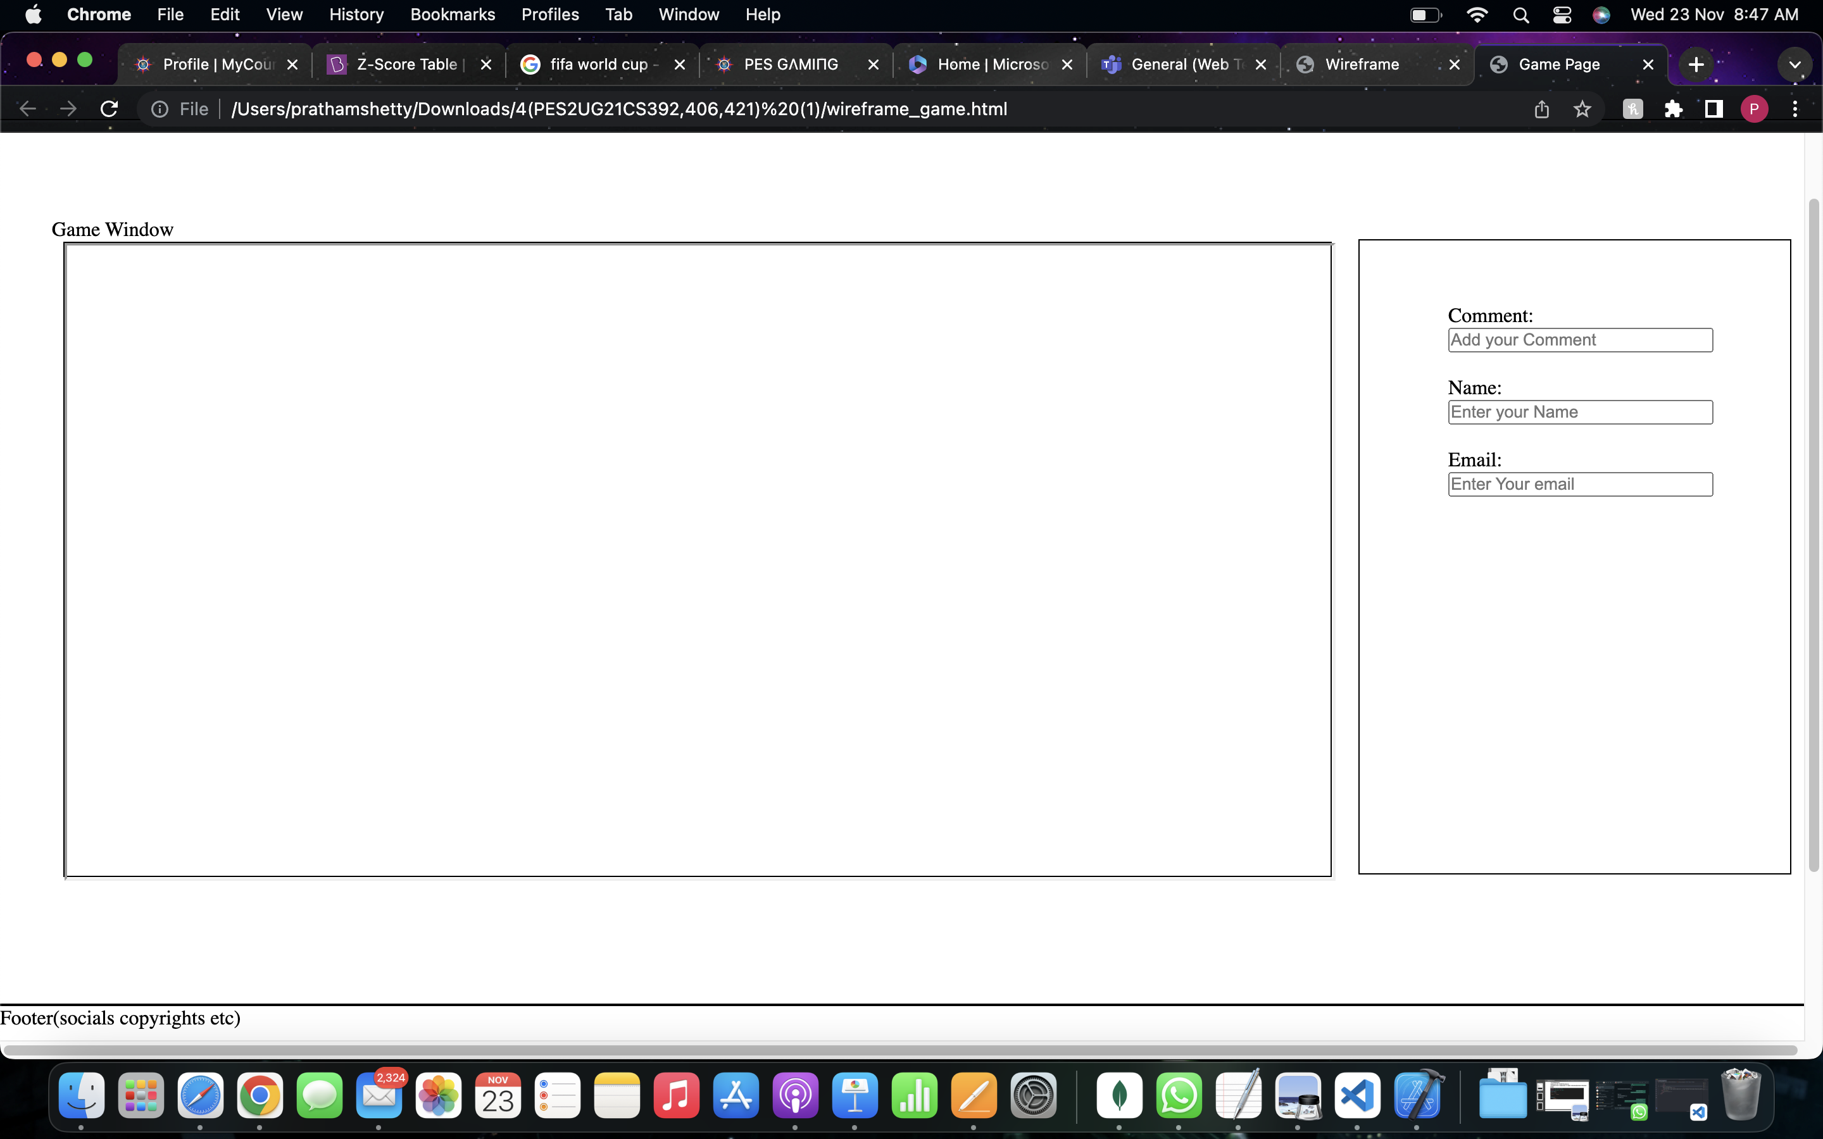
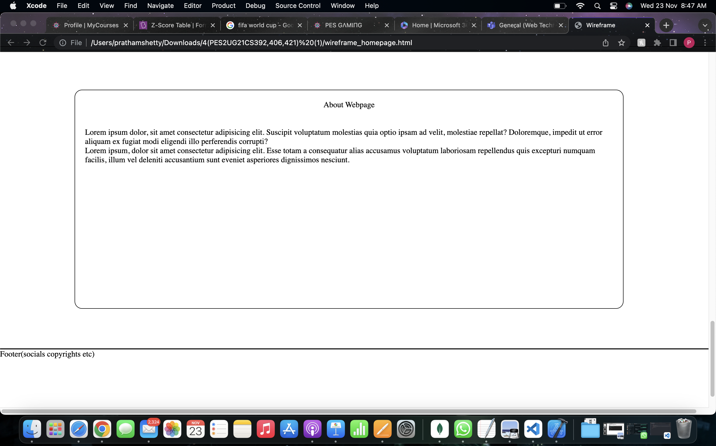
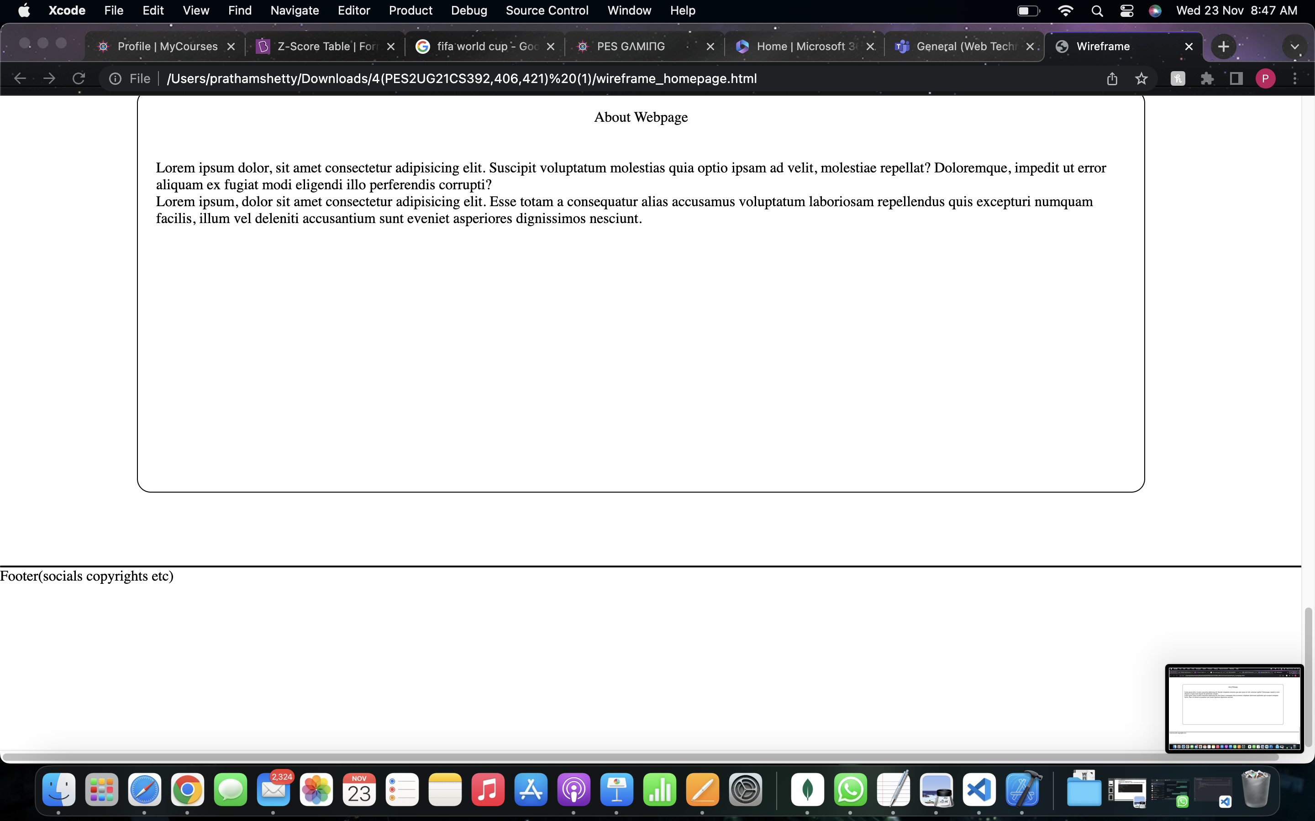

Slide 6
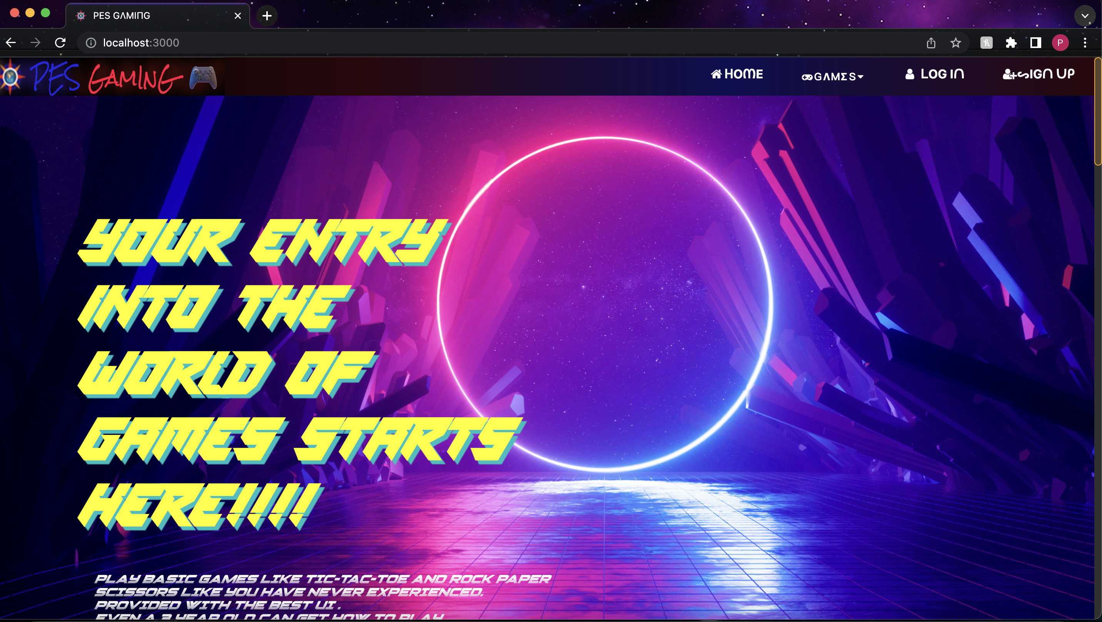
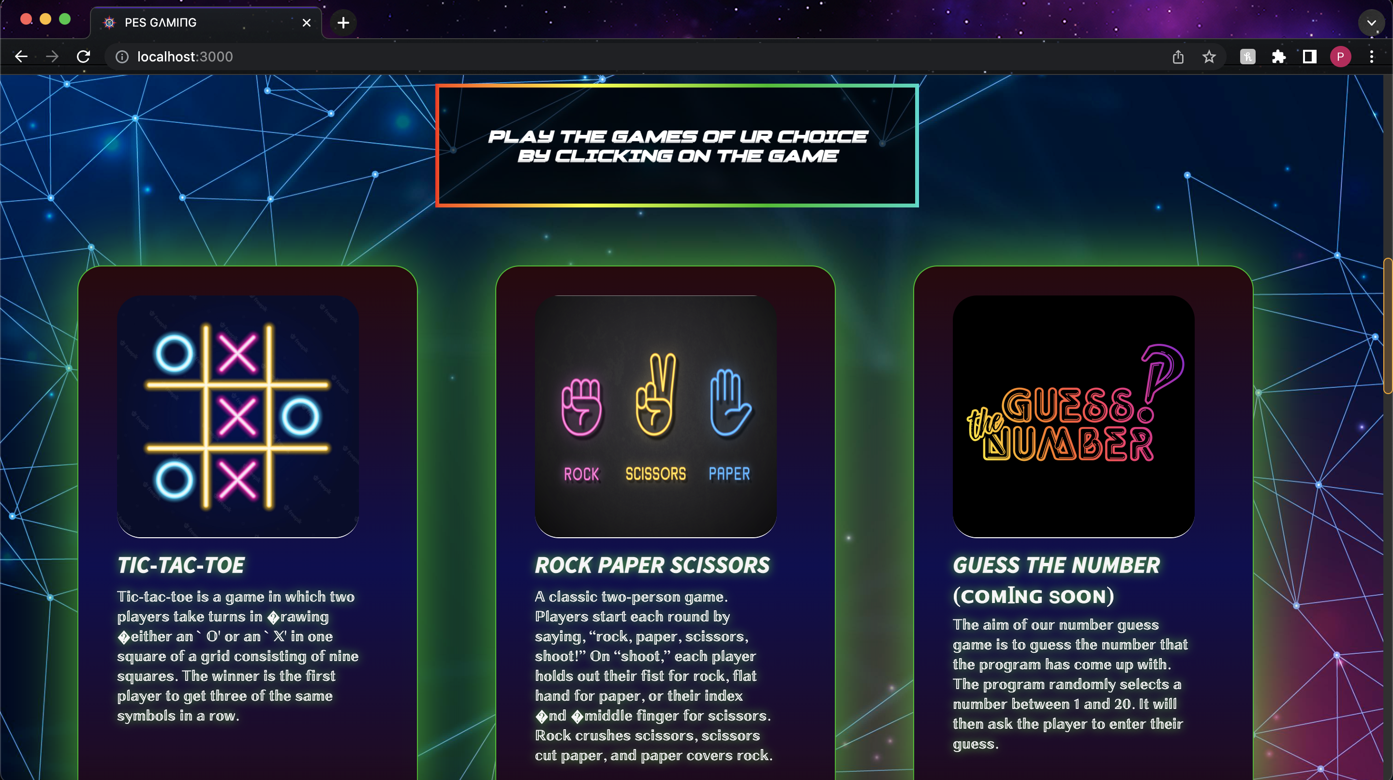
OUTPUT SCREENSHOTS
HOMEPAGE

Slide 7

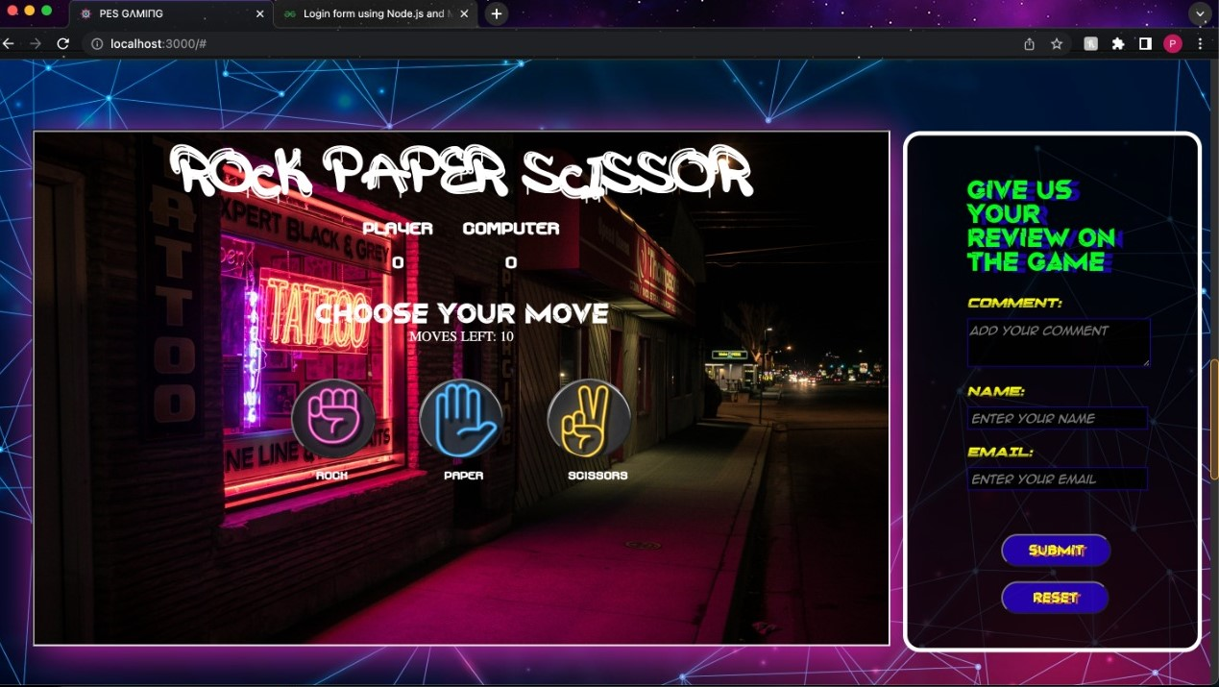
ROCK-PAPER-SCISSORS

Slide 8

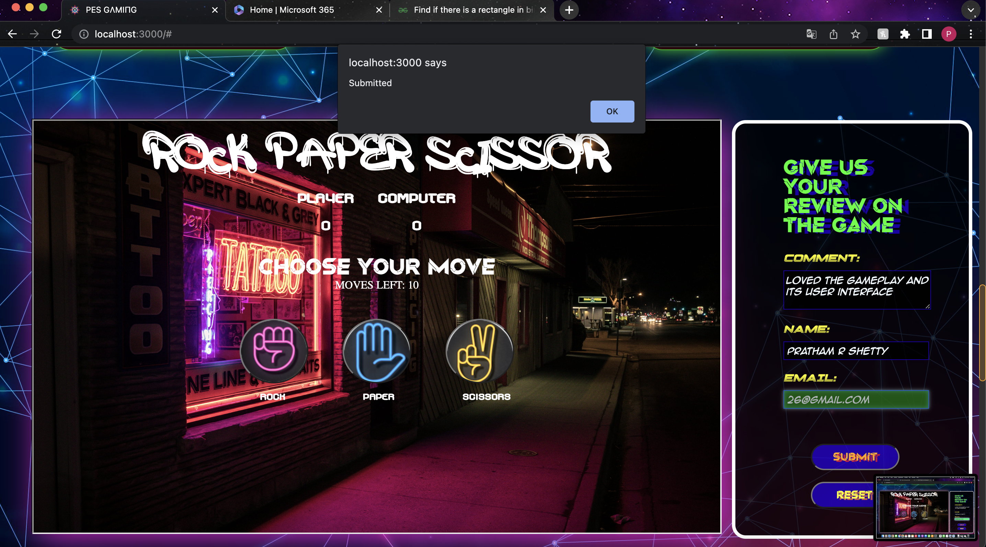
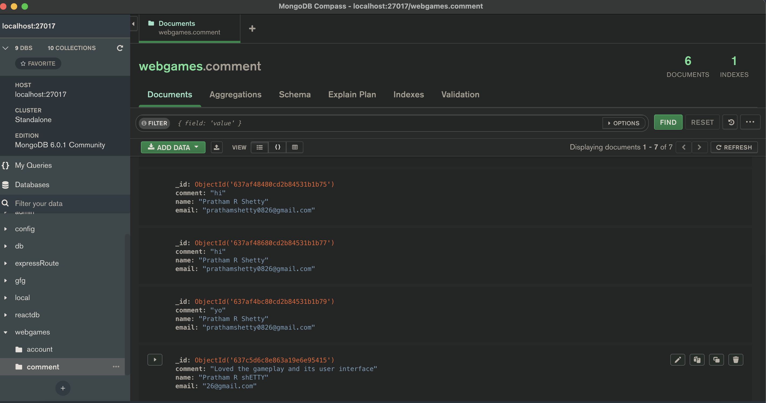
RESPONSE FROM USER AND STORED DATA

Slide 9

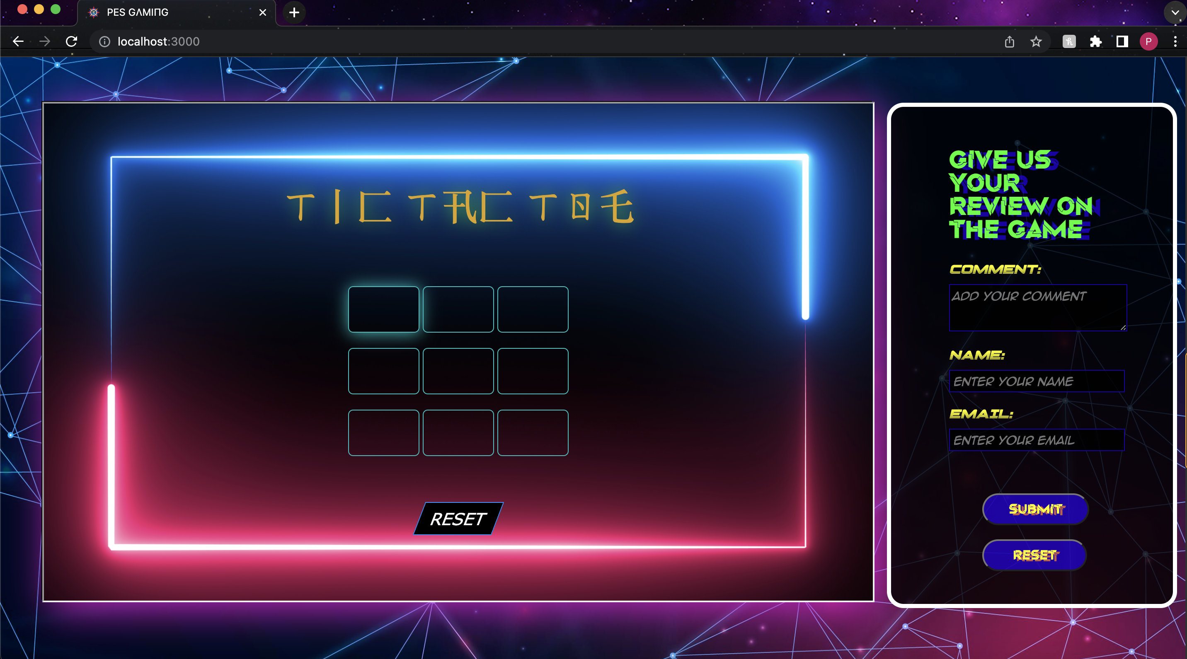
TIC-TAC-TOE

Slide 10
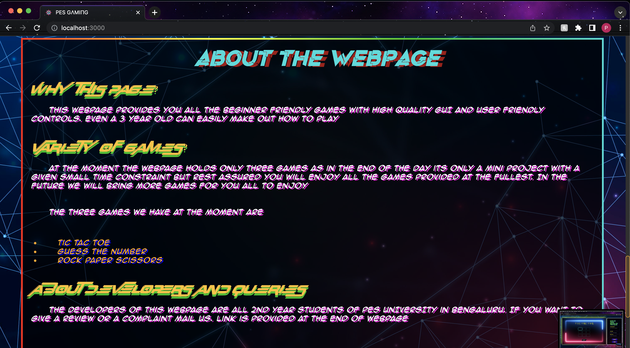
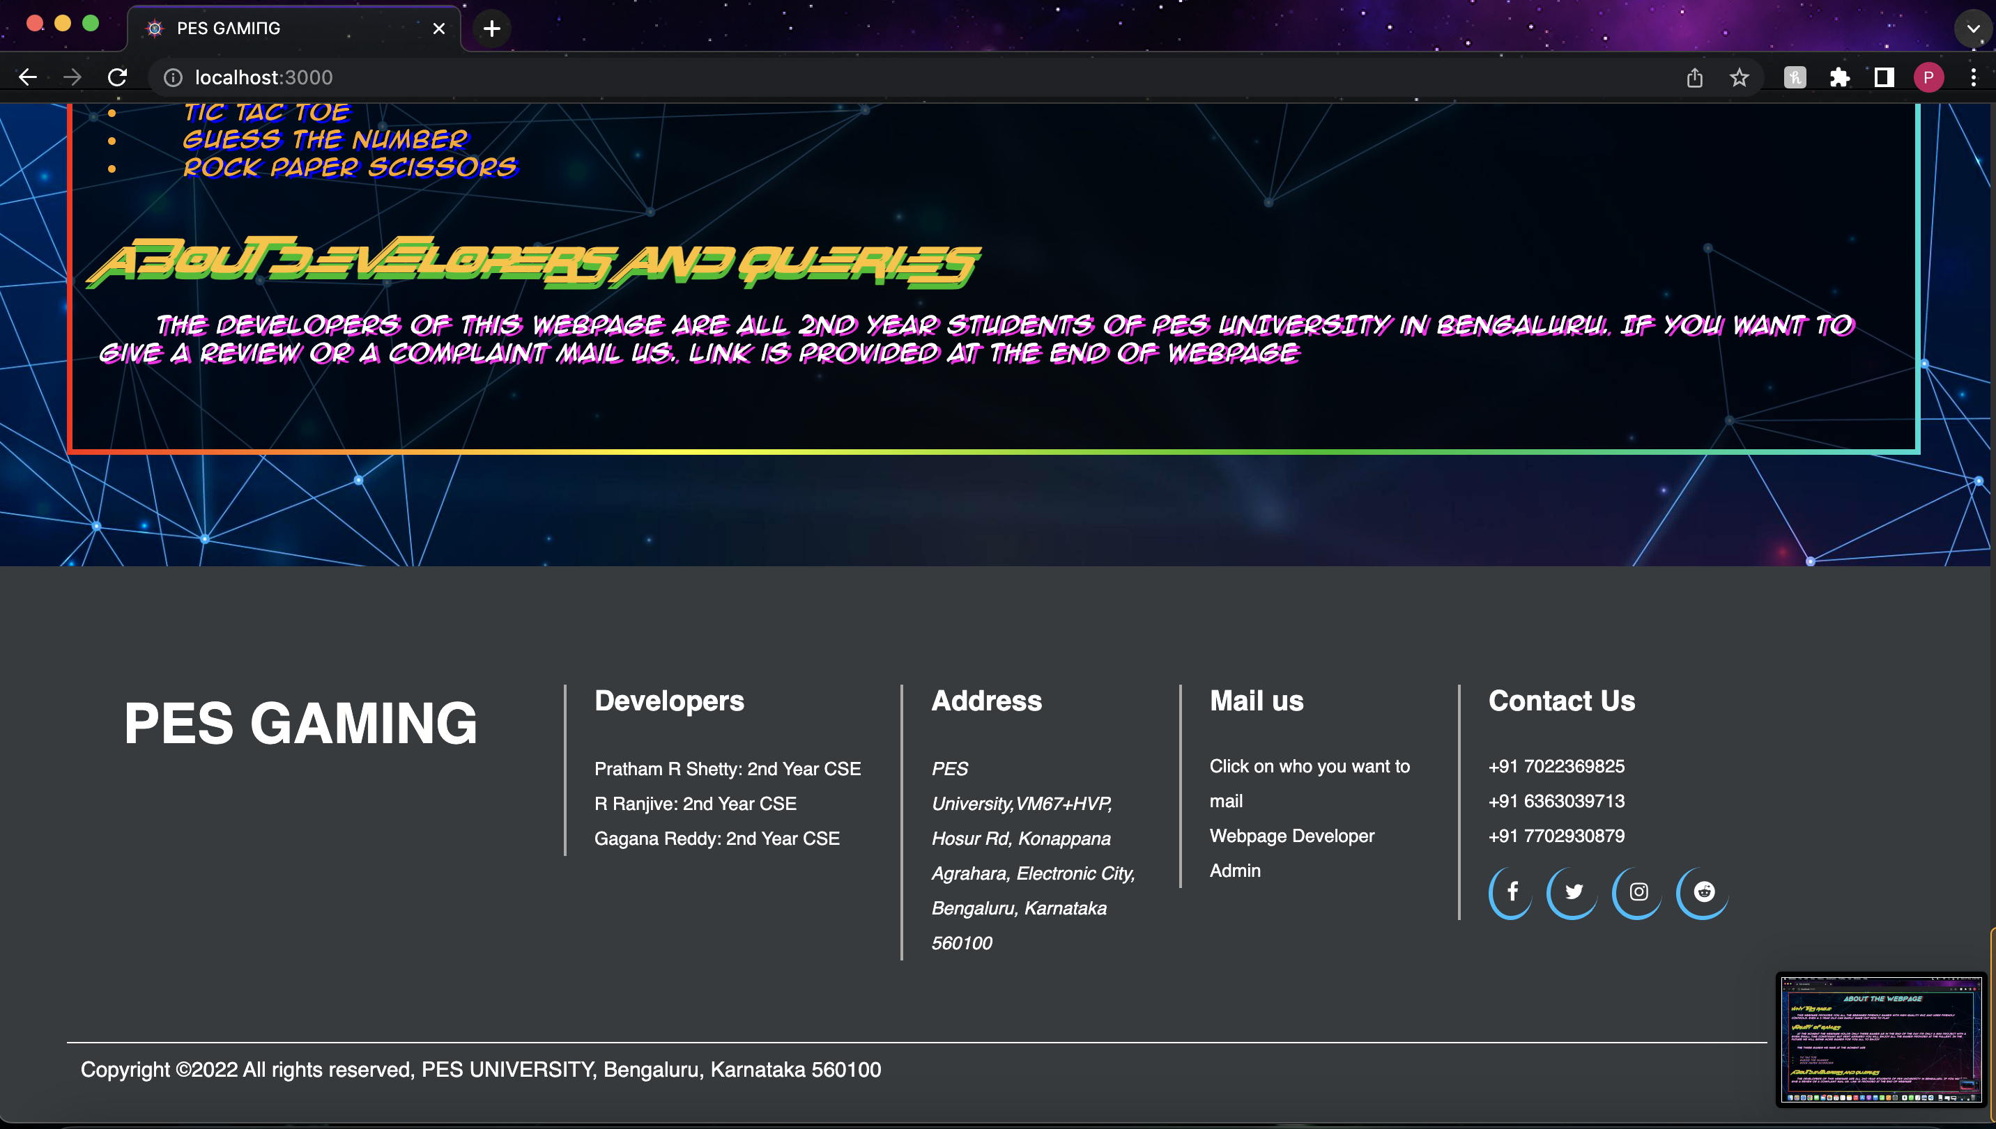
WEB PAGE And footer

Slide 11
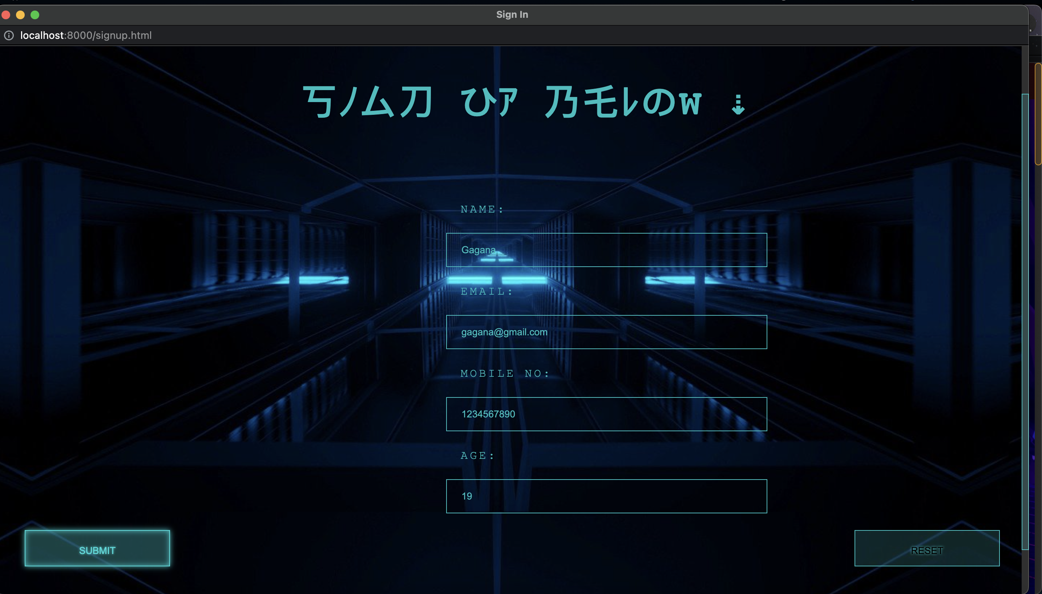
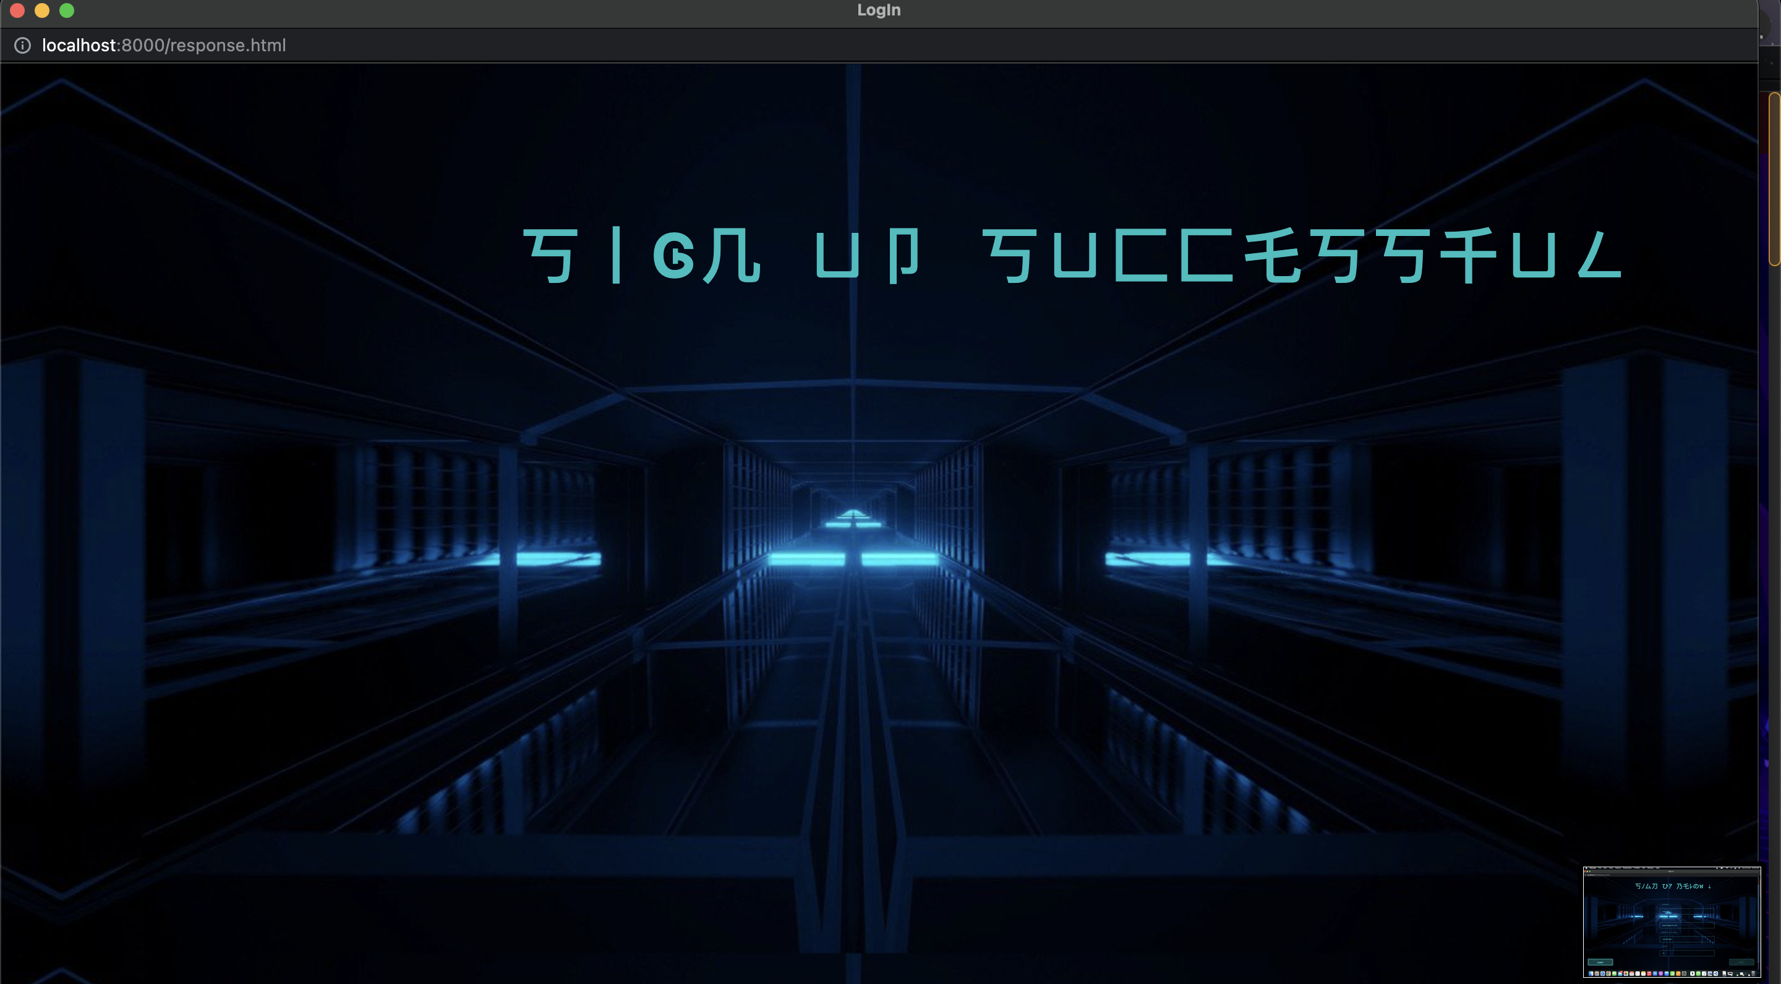
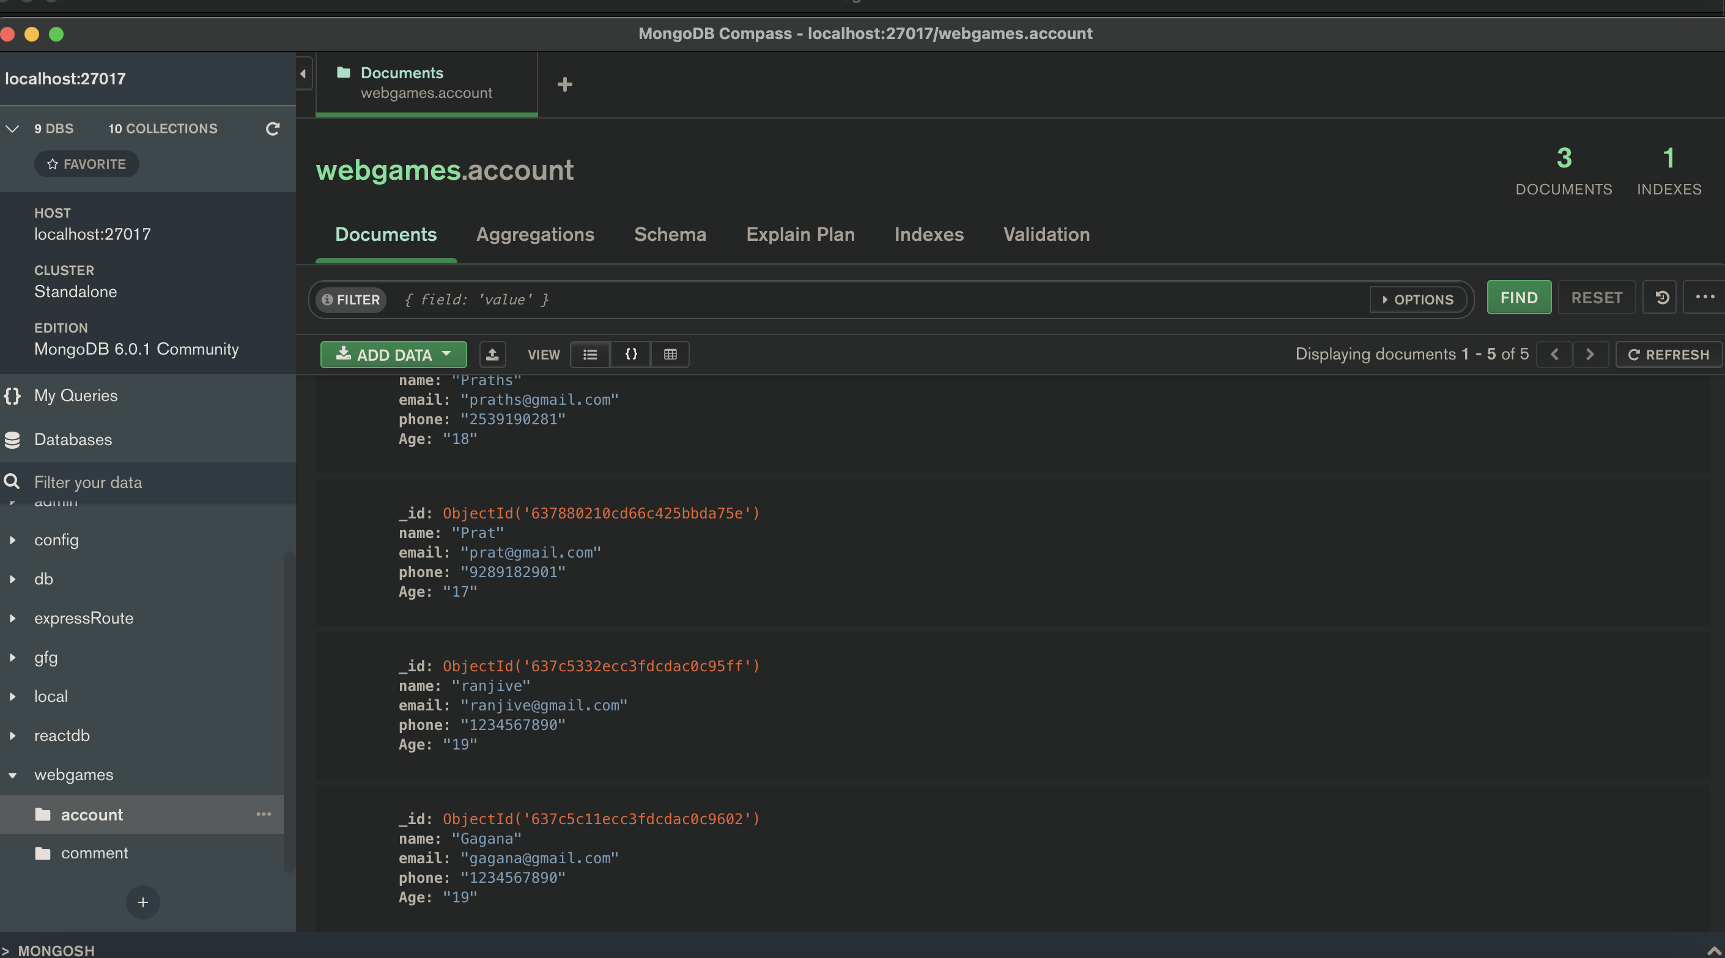
SIGN UP AND DATABASE

Slide 12
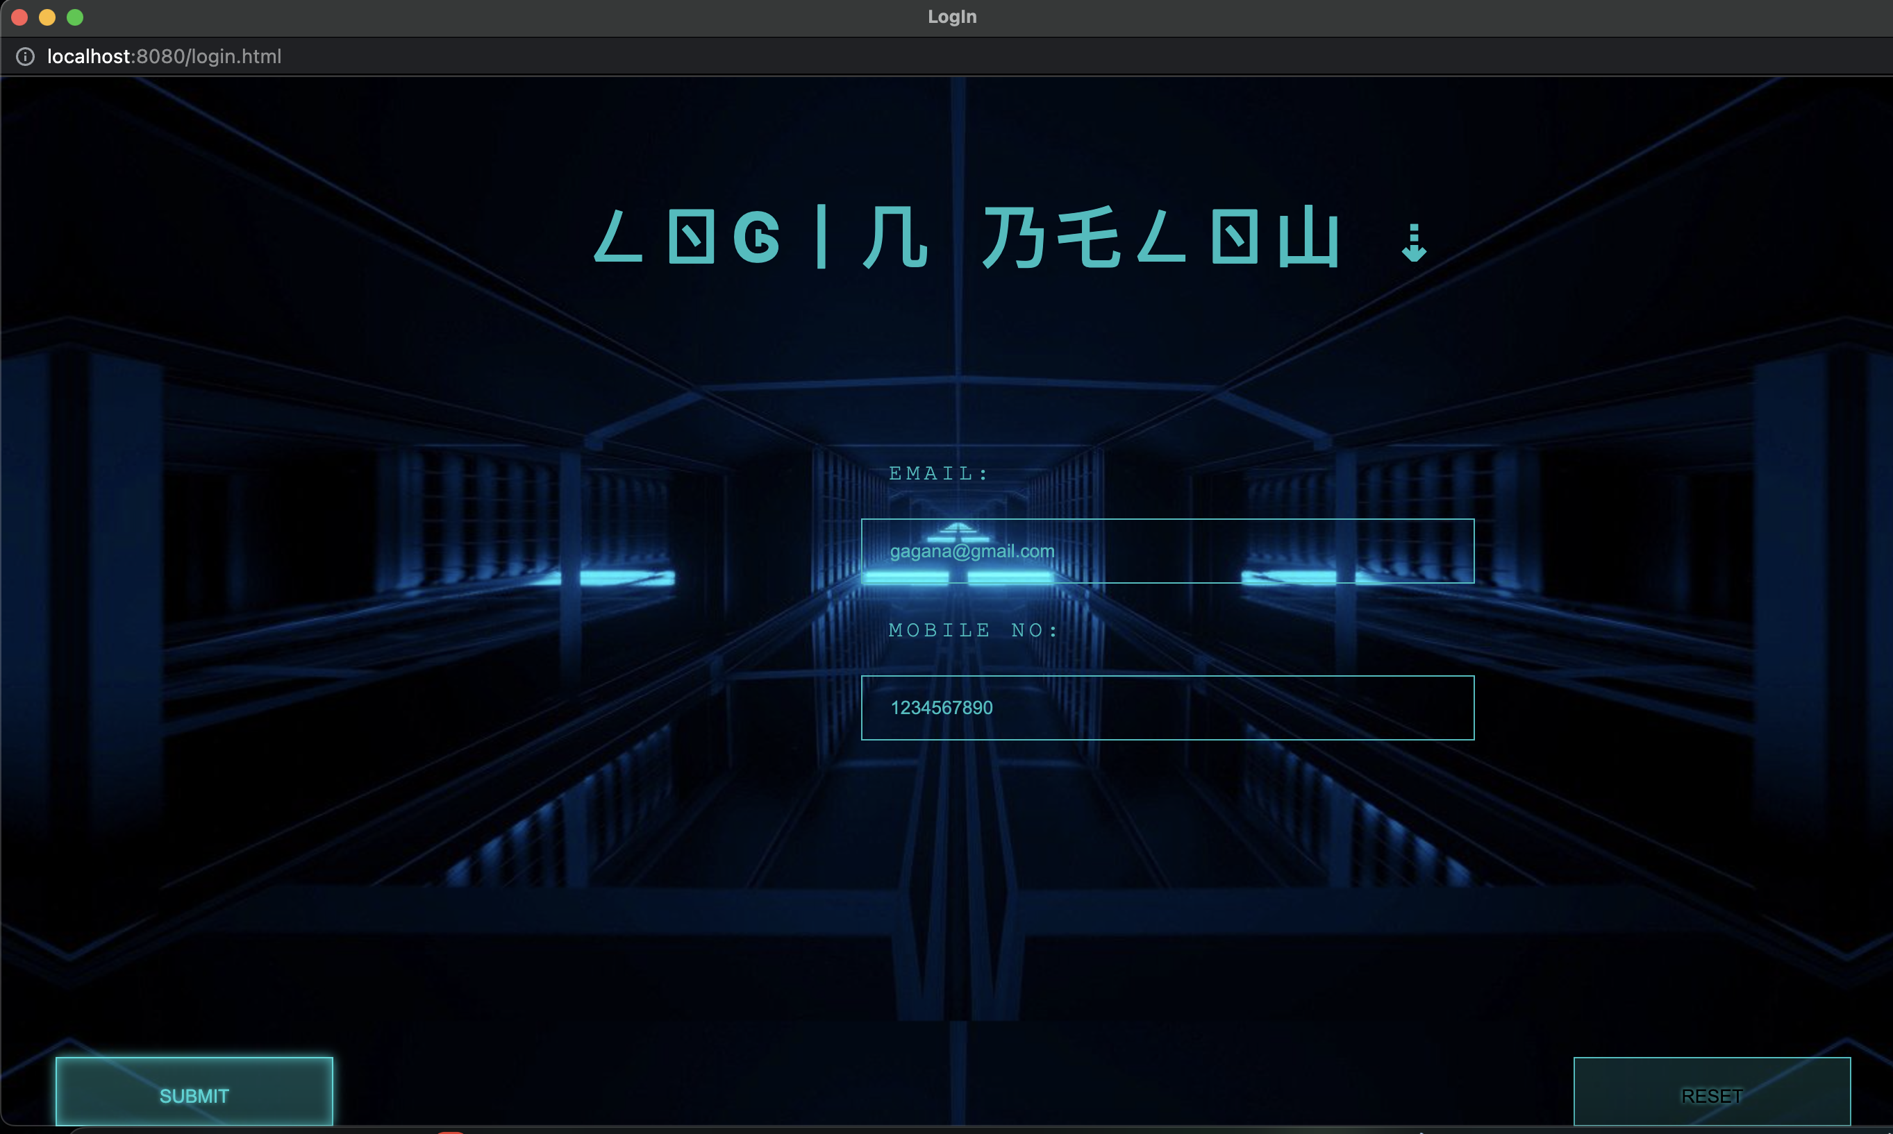
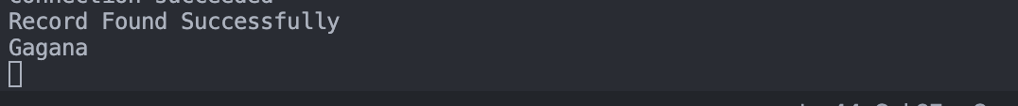
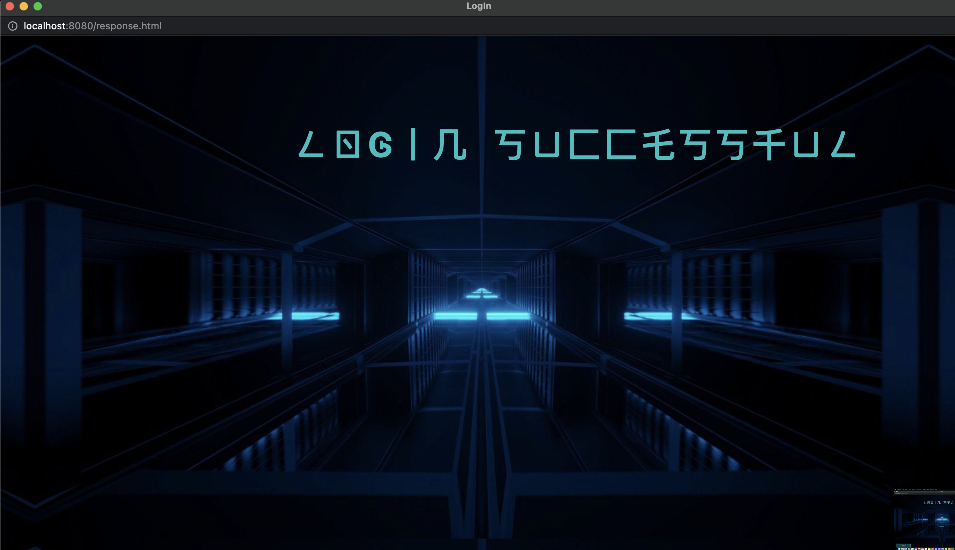
LOGIN PAGE AND USER DATA

Slide 13


